Slide 1
Types I
CMSC 330: Programming Languages

Slide 2
Type Errors
Static and Dynamic Typing
Primitive Data Types
Pointer vs. Reference
Structured Data Types
  Sum types
  Product types
  String

Slide 3
A type is a collection of values and operations on those values.
Example: Integer type has values ..., -2, -1, 0, 1, 2, ... and operations +, -, *, /, <, ...
The Boolean type has values true and false and operations ∧, ∨, ¬.

Slide 4
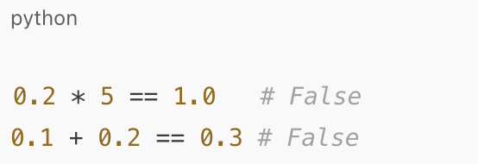
Types typically have a finite number of values due to fixed size allocation; problematic for numeric types
Exceptions:
  Smalltalk supports exact rational numbers (Fractions)
  Haskell type Integer represents unbounded integers
Even more problematic is fixed sized floating-point numbers:
  0.2 is not exact in binary---Why?
So 0.2 * 5 is not exactly 1.0
Notes:
Fixed size allocation means that a value is stored in a fixed number of bits
e.g. An int might use 32 bits
0.2 binary: There is no way of summing a finite series of powers of 2 and obtain exactly 0.2
Floating point is inconsistent with real numbers in mathematics

Slide 5
In the early languages, Fortran, Algol, Cobol, all of the types were built in
If needed a type color, could use integers; but what does it mean to multiply two colors?
Purpose of types in programming languages is to provide ways of effectively modeling a problem solution

Slide 6
Type Errors
Untyped Machine Data
  At the hardware level, memory is just a sequence of bits
  Type information is imposed by the programming language or runtime
Example: 0100 0000 0101 1000 0000 0000 0000 0000, could be
  The floating-point number 3.375
  The 32-bit integer 1,079,508,992
  Two 16-bit integers 16472 and 0
  Four ASCII characters: @ X NUL NUL
Notes:
Static typing motivation
The compiler knows types before execution
Can detect mismatches early
Prevents many invalid bit interpretations at compile time
Dynamic typing motivation
Type information is stored and checked at runtime
Allows flexibility while still preventing misuse
Runtime checks ensure bits are interpreted consistently

Slide 7
A type error is any error that arises because an operation is attempted on a data type for which it is undefined.
Type errors are common in assembly language programming.
High level languages reduce the number of type errors.
A type system provides a basis for detecting type errors.

Slide 8
Static and Dynamic Typing
A type system imposes constraints such as the values used in an addition must be numeric
  Cannot be expressed syntactically in EBNF
  Can often be expressed using contextual languages, using attribute grammars
Some languages perform type checking at compile time (e.g., C)
Some languages (e.g., Perl) perform type checking at run time
Ohers (e.g., Java) do both

Slide 9
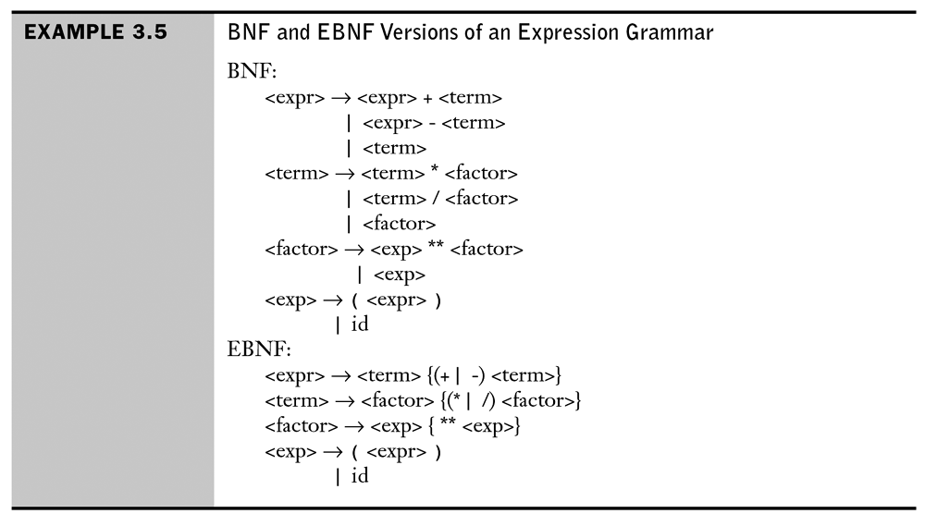
Attribute Grammars: An Example
Notes:
[Sebesta]

Slide 10
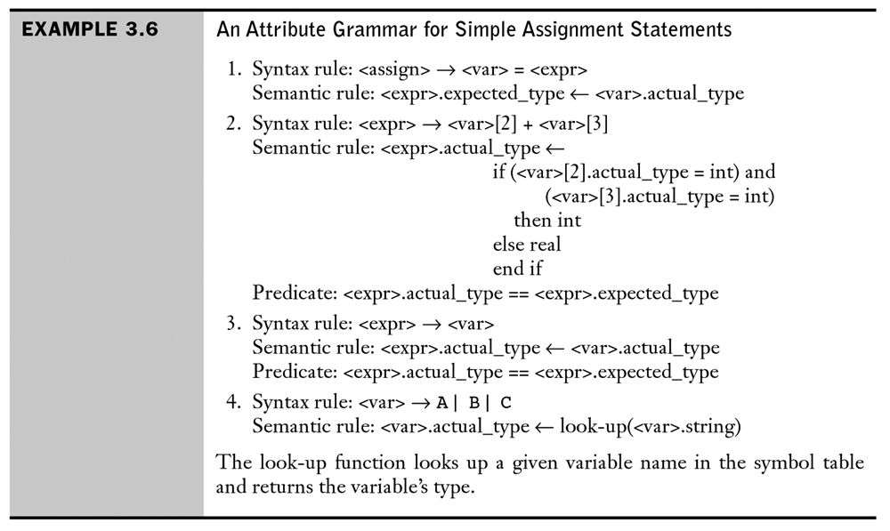
Attribute Grammars: An Example
Notes:
[Sebesta]

Slide 11
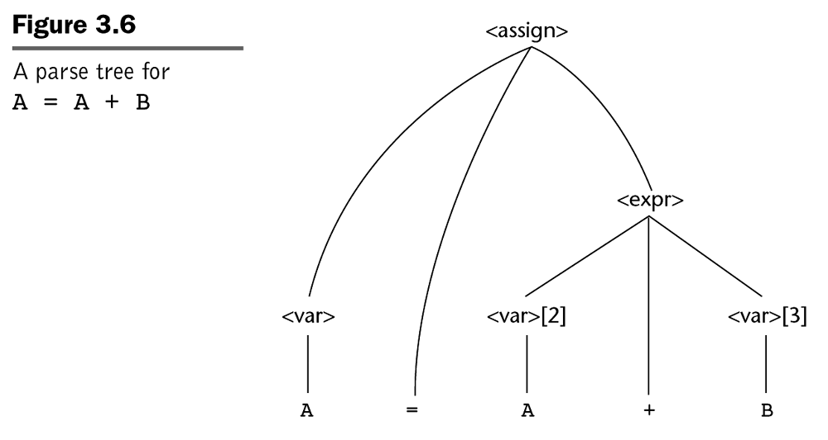
Attribute Grammars: An Example
Notes:
[Sebesta]

Slide 12
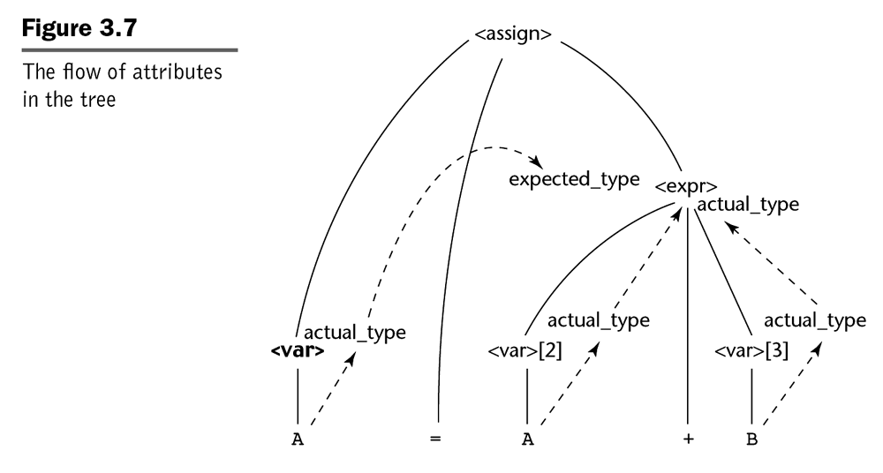
Attribute Grammars: An Example
Notes:
[Sebesta]

Slide 13
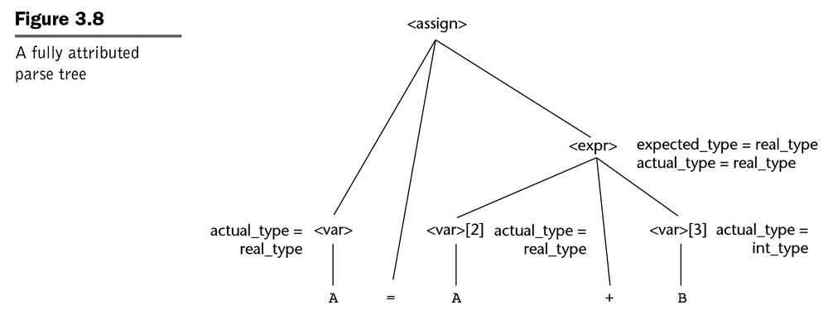
Attribute Grammars: An Example (End)
Notes:
[Sebesta]

Slide 14
A language is statically typed if the types of all variables are fixed when they are declared at compile time
A language is dynamically typed if the type of a variable can vary at run time depending on the value assigned
A language is strongly typed if its type system allows all type errors in a program to be detected either at compile time or at run time
A strongly typed language can be either statically or dynamically typed
Most dynamically typed languages associate a type with each value

Slide 15
Primitive Data Types
Typically represent atomic values (not composed of other types)
Often map directly to machine-level representations
Supported operations are implemented in hardware

Slide 16
Primitive Data Types: Boolean
Domain of values: True, False
Programming language specifies how values are stored and interpreted
Example:
  C/C++: 0 represents false, and non-zero represents true
  Java: explicitly true or false

Slide 17
Primitive Data Types: Integral Types
Represent whole numbers
Stored using a fixed number of bits
Most modern languages use two’s complement representation
Common sizes
  8-bit (char)
  16-bit (short)
  32-bit (int)
  64-bit (long)

Slide 18
Primitive Data Types: Character Types
Represent Represent textual data
Stored as numeric codes
Modern languages support Unicode characters
Character size varies by language
Encoding and representation are language-defined (e.g., ASCII, 16-bit Unicode, 32-bit Unicode)

Slide 19
Primitive Data Types: Floating-Point Types
Approximate representation of real numbers
Typically follow IEEE 754
Fixed size determines range and precision
Common Language Types
  float Python, C, C++, Java, OCaml, Ruby
  double C, C++, Java
  Float/Double Swift
  number TypeScript, JavaScript
  f32/f64 Rust

Slide 20
Primitive Data Types: Other Numeric Types
Decimal
  Exact decimal representation
  Useful for financial computations
  Slower and more memory-intensive than floating point
Complex Numbers
  Represented as a pair of floating-point values
    Is it truly a primitive type?
  Supported in some languages (e.g., Python, Fortran, C99)

Slide 21
An operator or function is overloaded when its meaning varies depending on the types of its operands or arguments or result.
Java: a + b (ignoring size)
  integer add
  floating point add
  string concatenation
  Mixed mode: one operand an int, the other floating point

Slide 22
Type Conversion: Widening vs Narrowing
A type conversion is a narrowing conversion if the result type permits fewer bits, thus potentially losing information, e.g., int -> char
Otherwise it is termed a widening conversion, e.g., int -> double
Should languages ban implicit narrowing conversions? Why?
Design Trade-off: Convenience vs. Safety
  C: many implicit conversions → convenient but error prone
  OCaml: almost no implicit numeric conversions

Slide 23
Pointer vs Reference
Pointer
  Stores the memory address of another value
  Can be reassigned to point to different objects
  Can be null
  Requires explicit dereferencing to access value
Reference
  Alias for an existing variable
  Must be initialized on declaration
  Cannot be null or changed to refer to another object

Slide 24
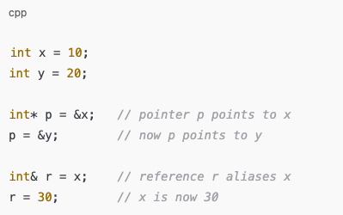
Pointer vs Reference Example

Slide 25

Pointer Example
struct Node {
int key;
struct Node* next;
};
struct Node* head;
--read: next is a pointer to Node, head is a pointer to Node
--or: Node *next, i.e., the object at address next is a Node
Node *head, i.e., the object at address head is a Node

Slide 26
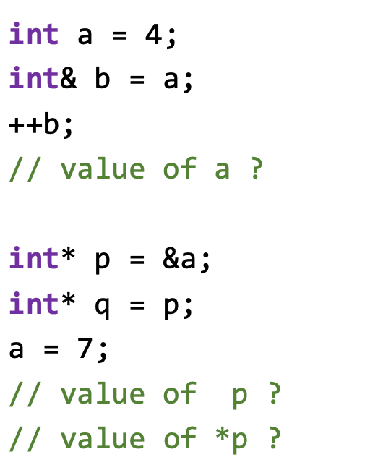
Case Study: C++

Slide 27
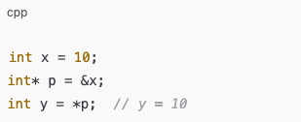
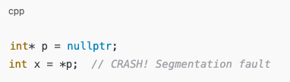
Dereferencing Pointers
Dereferencing: access the value stored at the address a pointer holds
Segmentation fault: runtime error caused by accessing memory you’re not allowed to touch (e.g., null or freed memory)

Slide 28
Memory: Stack vs Heap
Stack: stores local variables inside functions
  Automatic creation/removal when function runs
  Fast and temporary
  Lifetime is limited to function execution, so no need to delete
Heap: stores objects or variables that persist beyond a function (created dynamically)
  Managed automatically in modern languages like Java/OCaml
  Manually managed in C++ with new/delete
  C++ does not have garbage collection by default, must manually free heap memory

Slide 29
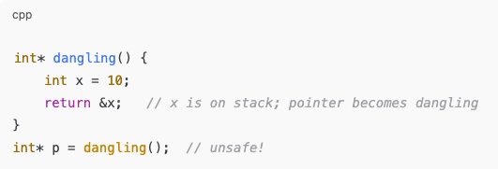
Dangling Pointers and Garbage Collection
Dangling pointer: points to memory that no longer exists
GC:
  Automatic process that reclaims heap memory that is no longer reachable by any pointer/reference
  Found in languages like Java, OCaml, Python
  Prevents dangling pointers and memory leaks

Slide 30

Structured Types: Sum Types
Sum type: value can be one of several alternatives
Use sum types to model choices, optional values, or errors
Enumerations
  Often used to define a new class of information
  E.g., Months, Card Suits

Slide 31
Sum Types: Optional
An optional type represents: either “a value exists” or “no value”
In OCaml:
type 'a option = None | Some of ‘a
In C++:
std::optional<int> x = 4;
Why using it?
  int option extends the domain of int by adding one extra value representing “no value”
  Consider the function find: string -> int
  OR string -> int option
Notes:
Examples: int option. string option bool option
What does Some of 'a mean?
It means:
the constructor Some stores one value of type ‘a
Why we use Optional (important intuition)
Without optional:
int find(); // what if not found?
You might return:
0? -1? error code? ambiguous
With optional:
std::optional<int> find();

Slide 32
Sum Types: Expected
Expected<T, E>: a sum type used for functions that can either succeed or fail
  T: type of the successful value
  E: type of the error
In C++
std::expected<std::string, ErrorType>
Failure: contains an ErrorType explaining what went wrong. E.g., when reading a file, we can define an ErrorType:
enum class FileError { NotFound, PermissionDenied };

Slide 33
Sum Types: Variant
Definition: A type whose value can be one of several alternatives, and each alternative can optionally store data
Only one alternative is active at a time
Can carry different types and numbers of values per alternative
Optional and Expected are specific types of variant
E.g.,
type shape =
| Circle of float
| Rectangle of float * float

Slide 34
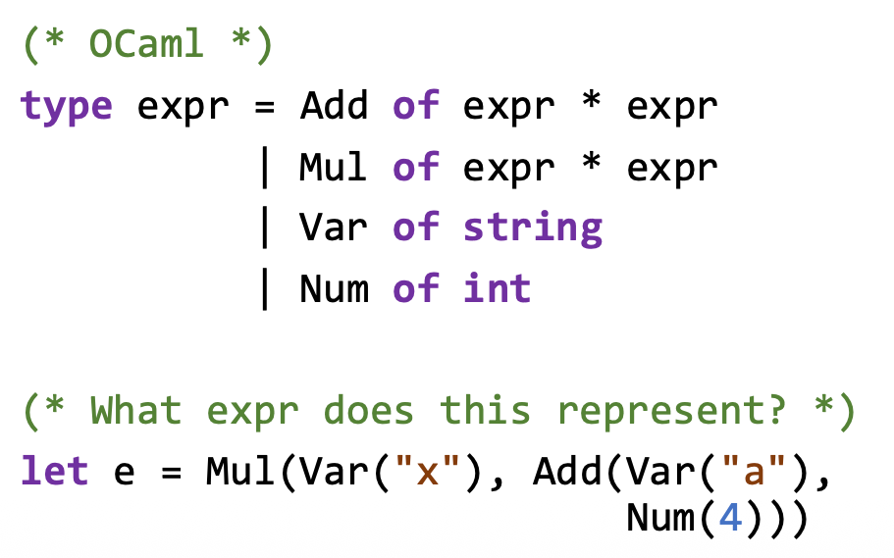
Variant Example

Slide 35
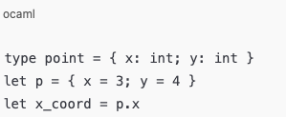
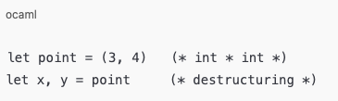
Product Types
Product type: combines multiple values into one object
Records
  A group of named attributes
  Access data via names
  In many languages, referred to as structs or classes
Tuples
  A group of unnamed attributes
  Access data by positions

Slide 36
Strings
In some languages, Strings are primitive types
  OCaml
  JavaScript
  Ruby
  Python
In other languages, they are not (thus library-defined)
  C++
  Swift
  Rust
  Java
In other languages, they don’t exist!

Slide 37
Strings
In some languages, strings are mutable
  Python
  JavaScript
  Rust (string)
In other languages, strings are immutable
  OCaml
  Java
    Any operation that looks like it modifies a string actually creates a new String object
  Rust (str)

